Slide 1
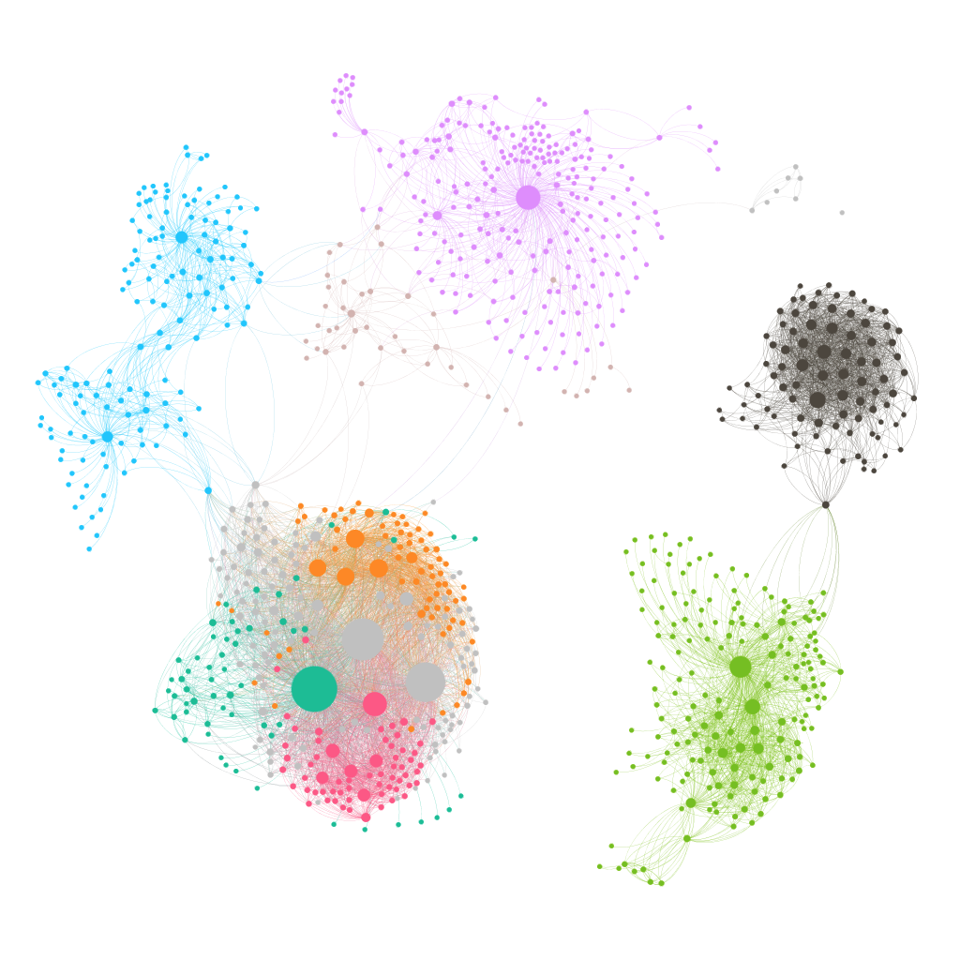

Visualizing New York City 311 Service Requests
Sam Goodgame
David Harding
Romulo Manzano

Slide 2
New York City 311
24/7 365 help with non-emergency services
Launched in March 2003
36 million requests for information or service in 2016
7.9% of that total were service requests, approx. 2.8m
Five boroughs, 40 agencies, more than 200 complaint types
6,000 – 8,000 new service requests each day
Varied response times: hours – months, with approx. 75% closed after a week

Slide 3
The Challenge: Visualizing Service Requests
Short Term - days:
How do agencies perform in the first week?
Which neighborhoods are experiencing slow response times?
Long Term - years:
What are the most common types of request?
Do they vary by borough?
Do they vary over time?
Is there a pattern to rare service requests?
Interesting questions depend on timescale

Slide 4
The Dataset: New York City 311 Service Requests
NYC OpenData
Access: Socrata Data API (SODA)
Updates: Automatic daily new entries and edits to existing entries
Data range: 1st January, 2010 through yesterday
Total of 15.9 million service requests
20GB csv file

Slide 5
The Solution: Two Approaches, Based on Data Volume
Analysis of Short Term Trends
Python / SODA Selected Data SQL Query Tableau Online
Analysis of Long Term Trends:
Full dataset to AWS HDFS Hive DDL SQL Tableau Online
Changes occur mainly in first seven days, including insertion of additional service requests. Subsequent changes relate to open / close status and closed date

Slide 6
Architecture: AWS, Hadoop, Hive, SQL, Python / SODA
Pull full csv into
AWS instance
NYC OpenData
Python script to pull recent rows
(c3.8xlarge)
Load selected columns into HDFS
Ingest
Processing
Serving
Transformation using Python
Extract data
with Hive SQL
Cloudera Hadoop
Tableau Online
CSV / Tableau Extracts

Slide 7
Limitations, Scale, Complexity
Data & Processing:
Structure / Quality: Structured data / Medium / high quality
Sink / Source latency: Daily
Size: MB and GB
Processing and Execution time: Medium / Short
Precision and Aggregation: Full / Medium
HDFS Hive Batch processing approach capable of handling much greater volume
Limitation on multiple end users customizing requests

Slide 8

Tableau Website

Slide 9
Conclusion: Issues / Challenges / Roadmap
Issues / Challenges:
Data inconsistencies – date input errors, use of 1900 as placeholder in first week
Short term data is messier than long term
Classification of complaint types could be simplified / aggregated for analysis
Roadmap for Future Development:
Combine external datasources to investigate 311 relationship to crime or property values
Create predictive model for expected time to closure
Create daily snapshot to enable analysis of short term trends
Automate quarterly update on long term data

